Slide 1
Mobile UX Design
A look at the elements of mobile UX design, best practice and implementation.

Slide 2
What is UX?
What's the difference between UI/UX?
UI – Visual Interface
UX – User Experience

Slide 3
What is UX?
Interface
The elements that go into representing the application visually to the user: Buttons, lists, images, etc.
Experience
How (easily) the user manipulates these elements to interact with the application.

Slide 4
What is UX?
The two elements are closely tied together and often referred to as one and the same, however they are subtly different.
Good UX is invisible, Bad UX is very, very visible.

Slide 5
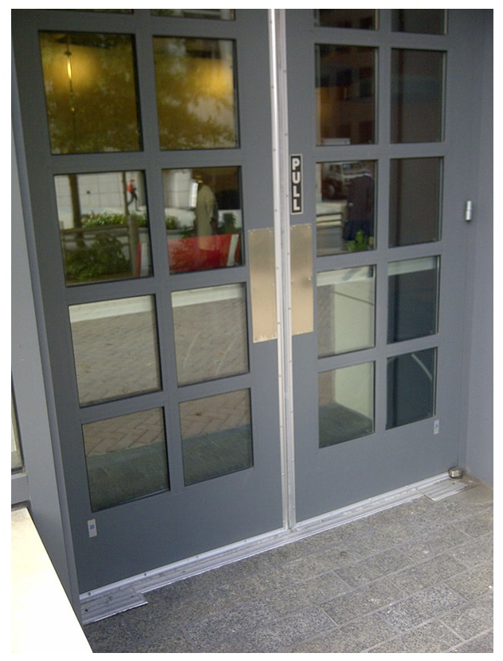
What is Wrong?

Slide 6
General Mobile Design
Discussing the elements of designing for a mobile device

Slide 7
Mobile User Input
When we design UX we must consider how the user will navigate and perform tasks in the application
How do users interact with a mobile device?
Touch Screen + Fingers / Stylus / Other
Sometimes not at all: “How can I help?” – Siri
Gestures

Slide 8
Mobile User Input
Mobile has limited options when it comes to inputs – it’s touch based.
These limitations impact how we design the user interface.
How is this limitation overcome?

Slide 9
Mobile User Input Cont.
Touch screens are better at allowing direct interaction with a UI. Users can move, swipe, drag and drop the elements in the UI to control behaviour of the application
Contextual Input – The same input responds differently on different views, items, buttons etc.

Slide 10
Mobile User Input Cont.
How many examples of user interaction on mobile that have been reduced to a simple movement?

Slide 11
Exercise: User Input
Pick an app on your mobile device, look through the app performing various tasks and consciously think about the inputs your using
Do you do something without thinking it?
Think of the Gallery/Photos How do you move between photos or get back?

Slide 12
Interface Inputs
As our means of controlling the application and providing input are reduced so are the elements we can use
It’s the functionality and gestures that allow us to achieve the user control in mobile apps

Slide 13
Interface Inputs
Example Controls:
Text Fields
Buttons
Toggles
Navs/Tabs
Lists/Cards/Cells
Etc…
When broken down there are actually very few elements in mobile interfaces.

Slide 14
UI Design
The visual elements that represent the interface of an application

Slide 15
UI Design
In UI design there are often style designs, commonly set by trends that highlight the elements of an interface.
These elements are:
Inputs
Navigation
Information
Containers
Collections

Slide 16
Components of UI Design
Each element can be varied in its components:
Colour
Depth
Animation/Motion
Shadows (or there lack of)
Typography
Scalability & Screen size

Slide 17
Flat Design
Invisible design – a UI design that’s not noticeable
Strips back design elements simplifying and prioritising use and function
Minimalist

Slide 18
Flat Design
Uses subtle shadows to convey layers and priority when working with multiple screens/views
Bold colours but complimentary and intentional vibrancy donates importance

Slide 19
Material UI
https://material.io/
This is a UI (and UX) set of guides that help define a design.

Slide 20


Material UI
Material Design is inspired by the physical world and its textures, including how they reflect light and cast shadows. Material surfaces reimagine the mediums of paper and ink.
Android OS

Slide 21
Apple Design Guidelines
Apple highlight three qualities:
Clarity
Deference
Depth
https://developer.apple.com/design/human-interface-guidelines/

Slide 22
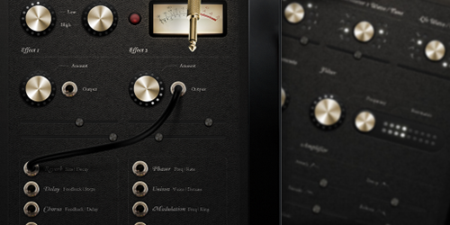
Skeuomorphism
Describes UI that represents the real-world object its imitating.

Slide 23



Skeuomorphism
What do these icons do?

Slide 24
Design “Style” Alternatives
These two articles present some alternatives:
https://usabilitygeek.com/alternatives-to-material-design/
https://www.slant.co/options/522/alternatives/~material-ui-alternatives

Slide 25
User Experience (UX)
How the application works with the users input to provide a seamless experience

Slide 26
Top UX Principles
Declutter the screen to allow what is important to be obvious to the user
Experience is key

Slide 27
Top UX Principles
With minimal space available, allow users to effortlessly transition between screens and areas of the app
Check out:
https://twitter.com/anton_skv

Slide 28
Top UX Principles
Functionality is always the drive behind the design choices
Minimise the need for a user to “work out” what they need to do to perform a particular action

Slide 29
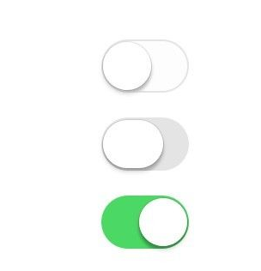
Outputs?
We have talked a lot of user input and inputs, but more often than not sets aside a good UX from a great one is output.
By output, we mean feedback.

Slide 30
Outputs?
This can be for an action taken, or a performed. A button clicked displays the button depress.
A toggle switched turns green when on (iOS). Or is greyed out when no longer usable.

Slide 31
Outputs?
Haptic feedback to represent turning or clicking.
Without this our user doesn’t know that either something has been done or is in the process of being done.

Slide 32
Recap
Intuitive
Human centred
Discoverable
Provide Feedback

Slide 33

Recap
https://www.youtube.com/watch?v=yY96hTb8WgI

Slide 34
Exercise
App redesign

Slide 35
Exercise
Using some of the topics we’ve discussed today, apply them to create a UI design/ UX for an app
Redesign your favourite app thinking of ways to improve it, or take an original idea and begin designing for its purpose

Slide 36
Exercise
Start with a rough sketch or Wireframe
Develop this into a colour or black & white mock-up

Slide 37
Exercise
Get some feedback from your peers
Refine the design based on feedback
Notes:
Figma: https://www.figma.com/
Adobe XD & Adobe Photoshop
Framer: https://www.framer.com/ui-ux-design-tool/
FluidUI: https://www.fluidui.com/
https://miro.com/features/
https://www.mockplus.com/free-wireframing-tool/
https://wireframe.cc/
https://pencil.evolus.vn/
https://ninjamock.com/
https://www.mockflow.com/
https://www.invisionapp.com/
https://www.axure.com/
https://www.invisionapp.com/product/craft
https://proto.io/
https://marvelapp.com/
https://www.flowmapp.com/
https://origami.design/
https://www.uxpin.com/

Slide 38
Exercise
Investigate applications you might be able to use to create these designs digitally
https://www.figma.com/
Adobe XD & Adobe Photoshop
https://www.framer.com/ui-ux-design-tool/
https://www.fluidui.com/
https://miro.com/features/
https://www.mockplus.com/free-wireframing-tool/
https://wireframe.cc/
https://pencil.evolus.vn/
https://ninjamock.com/
https://www.mockflow.com/
https://www.invisionapp.com/
https://www.axure.com/
https://www.invisionapp.com/product/craft
https://proto.io/
https://marvelapp.com/
https://www.flowmapp.com/
https://origami.design/
https://www.uxpin.com/
Notes:
Figma: https://www.figma.com/
Adobe XD & Adobe Photoshop
Framer: https://www.framer.com/ui-ux-design-tool/
FluidUI: https://www.fluidui.com/
https://miro.com/features/
https://www.mockplus.com/free-wireframing-tool/
https://wireframe.cc/
https://pencil.evolus.vn/
https://ninjamock.com/
https://www.mockflow.com/
https://www.invisionapp.com/
https://www.axure.com/
https://www.invisionapp.com/product/craft
https://proto.io/
https://marvelapp.com/
https://www.flowmapp.com/
https://origami.design/
https://www.uxpin.com/

